Slide 1


UK 100 m Resolution
Windstorm Data
Professor Mark Saunders and Dr Adam Lea
Department of Space and Climate Physics
University College London
Simplitium ModEx Webinar London
20th June 2018
Notes:
今天的伦敦大学学院
8个学院和72个课系
3,800名教学和研究员工
来自140个国家18,000名学生
拥有自己的剧院
拥有自己的博物馆和艺术收藏

Slide 2
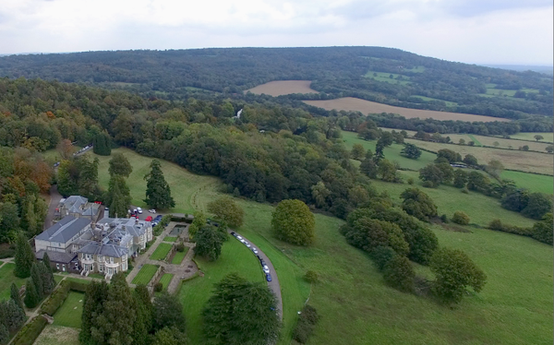
University Department
Space and Climate Physics Dept.
University College London
Holmbury St Mary, Surrey
Research graded 4* (outstanding) for impact (2014 REF).
Runner-up inaugural NERC International Impact Award 2015.

Slide 3
100 m Resolution Across the UK
Motivation
Windstorms are a substantial peril for the UK insurance industry [BIA, 2015].
Current methods for quantifying wind hazard across the UK are uncertain, lack spatial resolution and are based often on model outputs (Waisman, 2015; Met Office, 2015).
We have developed the UK 100 m resolution windstorm data to help companies better understand their wind risk.
These data map windstorm gust return levels and gust footprints on a 100 m grid for the whole UK, and robustly catalogue UK windstorm occurrence.

Slide 4
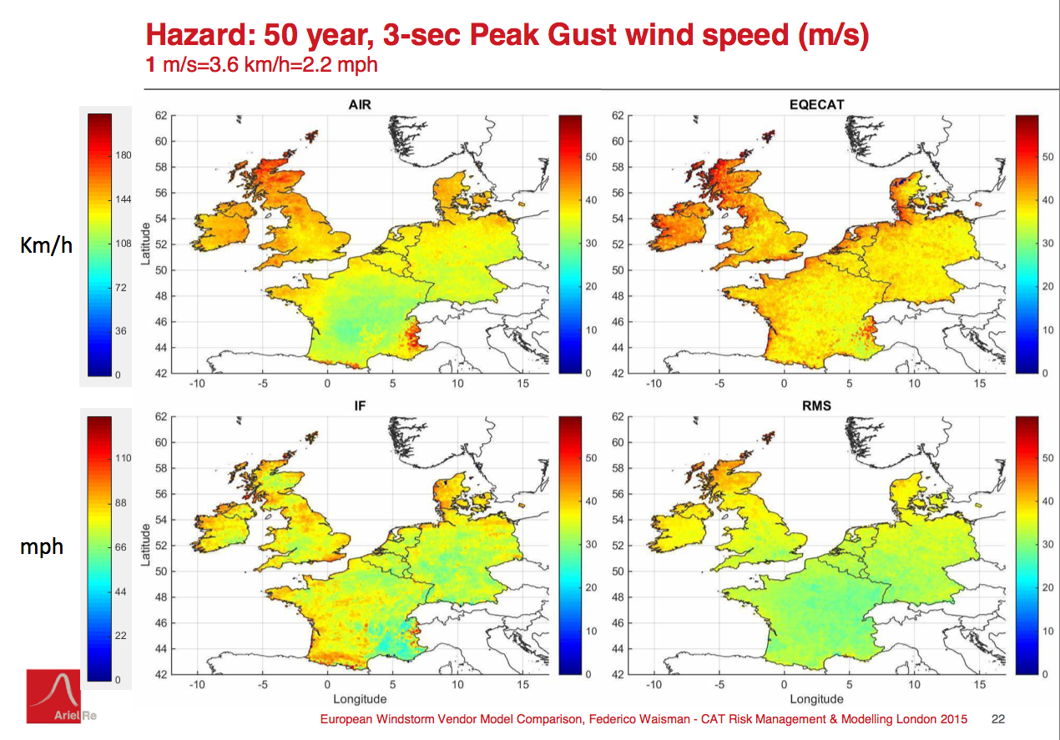
Models Disagree on UK Wind Hazard

Slide 5
Met Office UK Windstorm Gust Hazard Maps
Based on the output from a Numerical Weather Prediction model run over a 35-year period.
4.4 km spatial resolution.
Smoothed orography used.
Three standard return periods.
Figure shows UK windstorm 25-year gust return level [Met Office, 2015].

Slide 6
Three Data Products Created by UCL
UK 100 m resolution windstorm gust return levels.
UK 100 m resolution windstorm gust footprints.
UK windstorm catalogues and windstorm severity indices.
The mapping products offer almost 2000 times better spatial area resolution than the current state-of-the-art.
The UK 100m resolution windstorm data have been independently tested and licensed by the Direct Line Group.

Slide 7
Summary of Methodology for How the UK 100 m Resolution Windstorm Gust Data are Created
Input Data
Data Cleaning
Data Homogeneity Corrections
Extreme Value Analysis
Additional Wind Modifiers
Spatial Interpolation and Precision

Slide 8
Input Data
Hourly peak 3-sec gust data from 282 UK weather stations within the Met Office Integrated Data Archive System (MIDAS) [Met Office, 2012]. These data span the 45 year period 1969-2013. The 282 stations are spread uniformly across the UK.
UK land cover data at 100 m spatial resolution from the European Environment Agency’s CORINE land cover/land use database, version 17 [European Environment Agency, 2013].
UK terrain model height data on a 50 m grid from the Ordnance Survey [OS, 2016] and Ordnance Survey of Northern Ireland [OSNI, 2016].

Slide 9
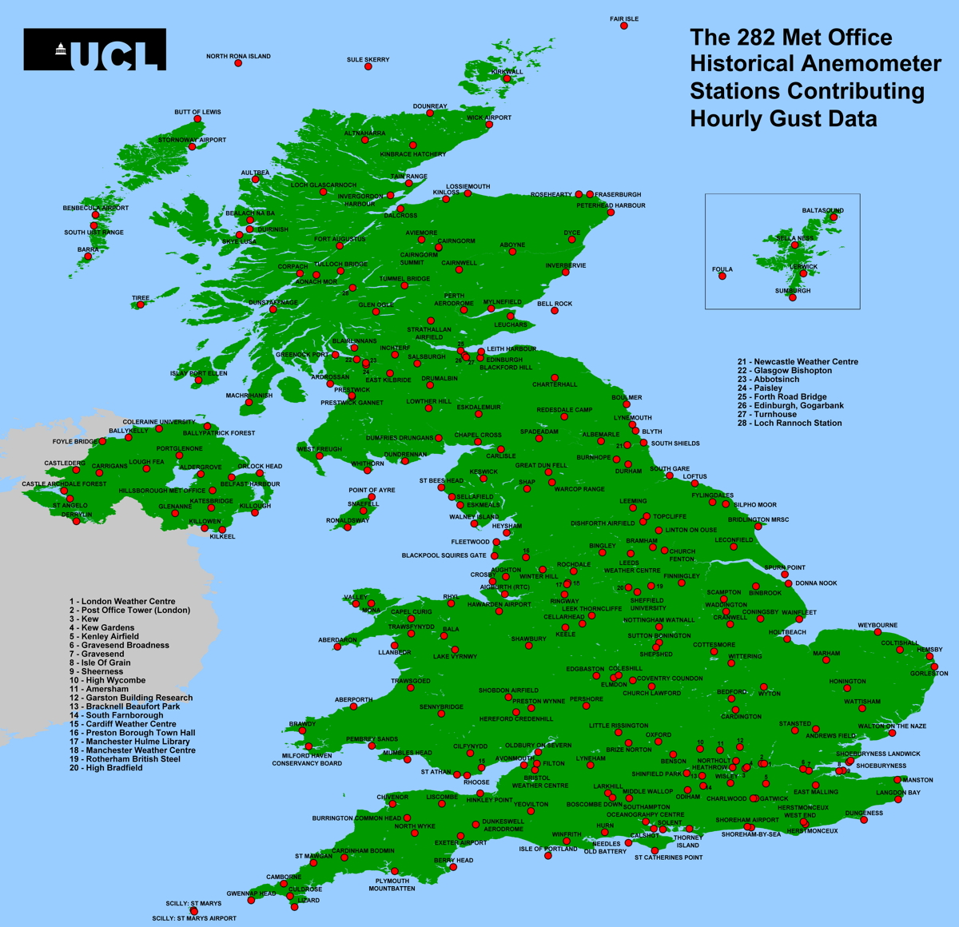
Locations of the 282 Met Office historical anemometer stations that contribute hourly 3-sec gust data to the UCL UK windstorm gust maps.

Slide 10
Data Cleaning
Standard and advanced quality control tests used to identify, remove and correct bad MIDAS station gust data.
Standard tests used include the identification of periods of data constancy and data repetition, the identification of sharp data jumps, and instances where data have clearly been digitised wrongly.
More advanced tests include the examination of gust factors and the identification of incorrect outliers through the use of station pressure data and the use of wind and pressure data from nearby stations.
The data cleaning led to over 4000 MIDAS wind and gust records 1969-2013 being either removed or corrected.

Slide 11
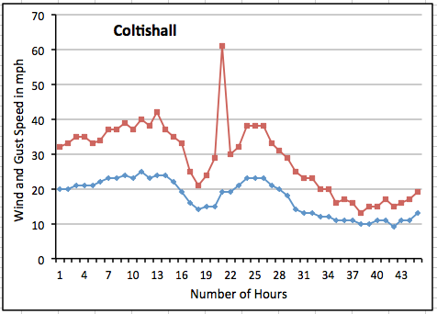
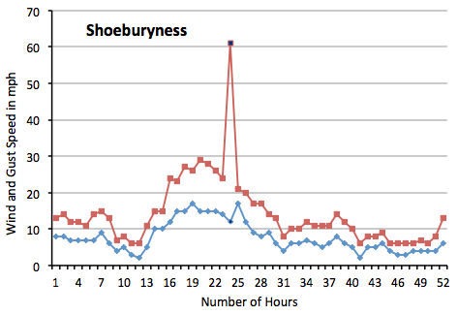
Examples of Gust Data Corrections
Coltishall, Norfolk.
MIDAS WM hourly data 14-16th Nov 1974.
Peak 3-sec gust of 61 mph corrected to 31 mph.
Shoeburyness, Essex.
MIDAS WM hourly data 22-24th Jan 1994.
Peak 3-sec gust of 61 mph corrected to 21 mph.

Slide 12
Data Homogeneity Corrections
Three corrections are made to homogenise the MIDAS UK station gust records. These are:
The location of the 282 MIDAS stations has been determined to 10 m precision. This precision is desirable to reduce errors in the modelling of the gust perturbations due to local orography and to upstream suraface roughness.
Gust data imputation has been performed to give complete 45-year hourly and daily maximum gust coverage at all 282 stations. This homogenisation is desirable to avoid biases in the computed return levels cause by gaps in the hourly gust record.
The effective heights of the MIDAS 3-sec gust recordings 1969-2013 have been standardised to 10 m where possible. 73 station anemometers had non-standard effective heights (ranging between
5 m and 160 m) for at least part of the 1969-2013 period.

Slide 13
Extreme Value Analysis
Extreme gust return levels are computed from the cleaned and homogenised hourly station gust data by using the method of independent storms combined with a robust peak-over-threshold analysis.
Our method uses all the hourly gust data over 45 years for every station but our database of extreme gusts employed for the extreme value analysis comprises the highest gust value per independent storm at each station.
The gust return levels and their associated 95% confidence intervals for each station are determined using the extreme value procedures and diagnostic tests described in Coles [2001]. The distribution of gust exceedances above different extreme gust thresholds is modelled using the Generalised Pareto Distribution.

Slide 14
Additional Wind Modifiers
1. Influence of Orography
The velocity perturbations due to three-dimensional orography are computed at 100 m resolution using the Jackson-Hunt [1975] theory combined with a spectral Fourier transform solution. Speed-ups and speed-downs in gust speed occur respectively on upslopes and downslopes.
2. Influence of Upstream Surface Roughness
The velocity perturbations due to upstream roughness are computed at 100 m resolution by assigning surface roughnesses to each of the 44 separate CORINE land cover codes, and empirically determining an optimised upstream inverse distance weighting model for the effective upstream roughness and its percentage change in gust speed.

Slide 15
Spatial Interpolation and Precision
Spatial Interpolation: Multiple regression is used to model the spatial variation of each gust return level in terms of five variables:
- orography
- upstream surface roughness
- altitude, latitude and longitude.
This regression model is applied at each 100 m grid cell and the output added to an interpolated gust residual to give a complete UK mapping of gust return level at 100 m resolution.
Uncertainty arising from spatial interpolation: 6-7% (gust return levels).
8% (gust footprints).
(Computed by excluding each of the 282 stations in turn from the multiple regression and spatial analysis).

Slide 16
Product 1: UK 100 m Resolution
Windstorm Gust Return
Levels
Offers windstorm gust return levels on a 100 m grid for the whole UK for gust return levels between 1 year and 1000 years. A 95% confidence interval is included for each gust return level.

Slide 17
50-yr Gust Return Level and Uncertainty
Upper 95% confidence bound
Lower 95% confidence bound

Slide 18
UK 100m Gust Return Levels: Example 1
Winchester
St Catherine’s Hill
4.4 km

Slide 19
UK 100m gust return levels: Example 2
50yr Gust Return Level (mph)
Edinburgh City Centre
Arthur’s Seat
Edinburgh Castle
4.4 km
Notes:
今天的伦敦大学学院
8个学院和72个课系
3,800名教学和研究员工
来自140个国家18,000名学生
拥有自己的剧院
拥有自己的博物馆和艺术收藏

Slide 20
UK 100m gust return levels: Example 3
Location: North Downs in Surrey
near to UCL Dept.
50yr Gust Return Level (mph)
50 yr 3-sec gust return level at UCL Department is 90 mph. (This compares to ~60 mph in nearby Holmbury St Mary village).
50 yr gusts on Holmbury Hill anticipated to be higher than on Leith Hill.
Previous best spatial resolution (4.4 km) is shown for reference.
Holmbury St Mary
Leith Hill
UCL Dept.
4.4 km
Notes:
今天的伦敦大学学院
8个学院和72个课系
3,800名教学和研究员工
来自140个国家18,000名学生
拥有自己的剧院
拥有自己的博物馆和艺术收藏

Slide 21
Comparison of 2-yr and 200-yr Levels

Slide 22
Range of Errors (282 station points)
All errors computed using ‘cross-validation’ by excluding each station in turn from the multiple regression and spatial analysis.
Mean percentage errors for 50 yr and 200 yr gust return levels are 6.4% and 6.8% respectively.

Slide 23
Product 2: UK 100 m Resolution
Windstorm Gust
Footprints
Offers windstorm gust footprints on a 100 m grid for the whole UK for 394 windstorms 1969-2013, and for new UK windstorms within about 24 hours of each storm’s UK passage.

Slide 24
UK 100 m Windstorm Gust Footprints (1)

Slide 25
UK 100 m Windstorm Gust Footprints (2)

Slide 26
Precision
Assessed (opposite) for 14 UK windstorms.
The ‘cross-validated’ assessment excludes each station in turn from the spatial gust footprint development.

Slide 27
Gust Footprints for 2017-18 UK Windstorms
Notes:
Current methods for estimating UK wind hazard are highly uncertain, are often based on model outputs, and

Slide 28
Product 3: UK Windstorm Catalogues and Windstorm Severity
Gradings
Offers robust UK windstorm catalogues 1969-2013 and windstorm severity indices based solely on observational data and provided for the UK and uniquely for 11 UK regions.

Slide 29
UK Windstorm Catalogues and the 11 UK Regions
Underpinned by high quality observational data and by a consistent windstorm definition (using firm thresholds for gust speed and storm size exceedance).
Contains 394 events.
Windstorm severity is defined in terms of the average wind power per station (using 262 low-level sites).

Slide 30
Most Severe SE England and NW England Windstorms 1969-2013 Ranked by Severity
The range of storm wind powers within each region and between
the regions is evident.

Slide 31
Grid and File Formats
The UK 100 m Resolution Windstorm Data are:
Gridded at 100 m resolution on the Ordnance Survey Grid (also called the British National Grid).
Available as NetCDF files for display in ArcGIS and as high resolution PNG static images.
The windstorm catalogues and windstorm severity indices are available in excel files.

Slide 32
Range of Uses
UK insurers could make use of the UK 100 m resolution windstorm data to help inform/improve their:
Rating areas and technical pricing of property insurance.
Portfolio level risk accumulation.
Identification of areas with high exposure to damaging wind speeds.
Windstorm catastrophe model evaluation.
Early assessment of potential claims numbers following the passage of new UK windstorms (eg ex-hurricane Ophelia).

Slide 33
Summary
The UK 100 m resolution windstorm data have been developed to help you better understand your wind risk.
These data:
Are underpinned by observations.
Include the influence of orography and surface roughness.
Provide almost 2000 times better spatial area resolution than the current state-of-the-art.
Have been independently tested and licensed by the Direct Line Group.

